Slide 1
SalesMax.Ai
Humanize processes for better opportunites

Slide 2
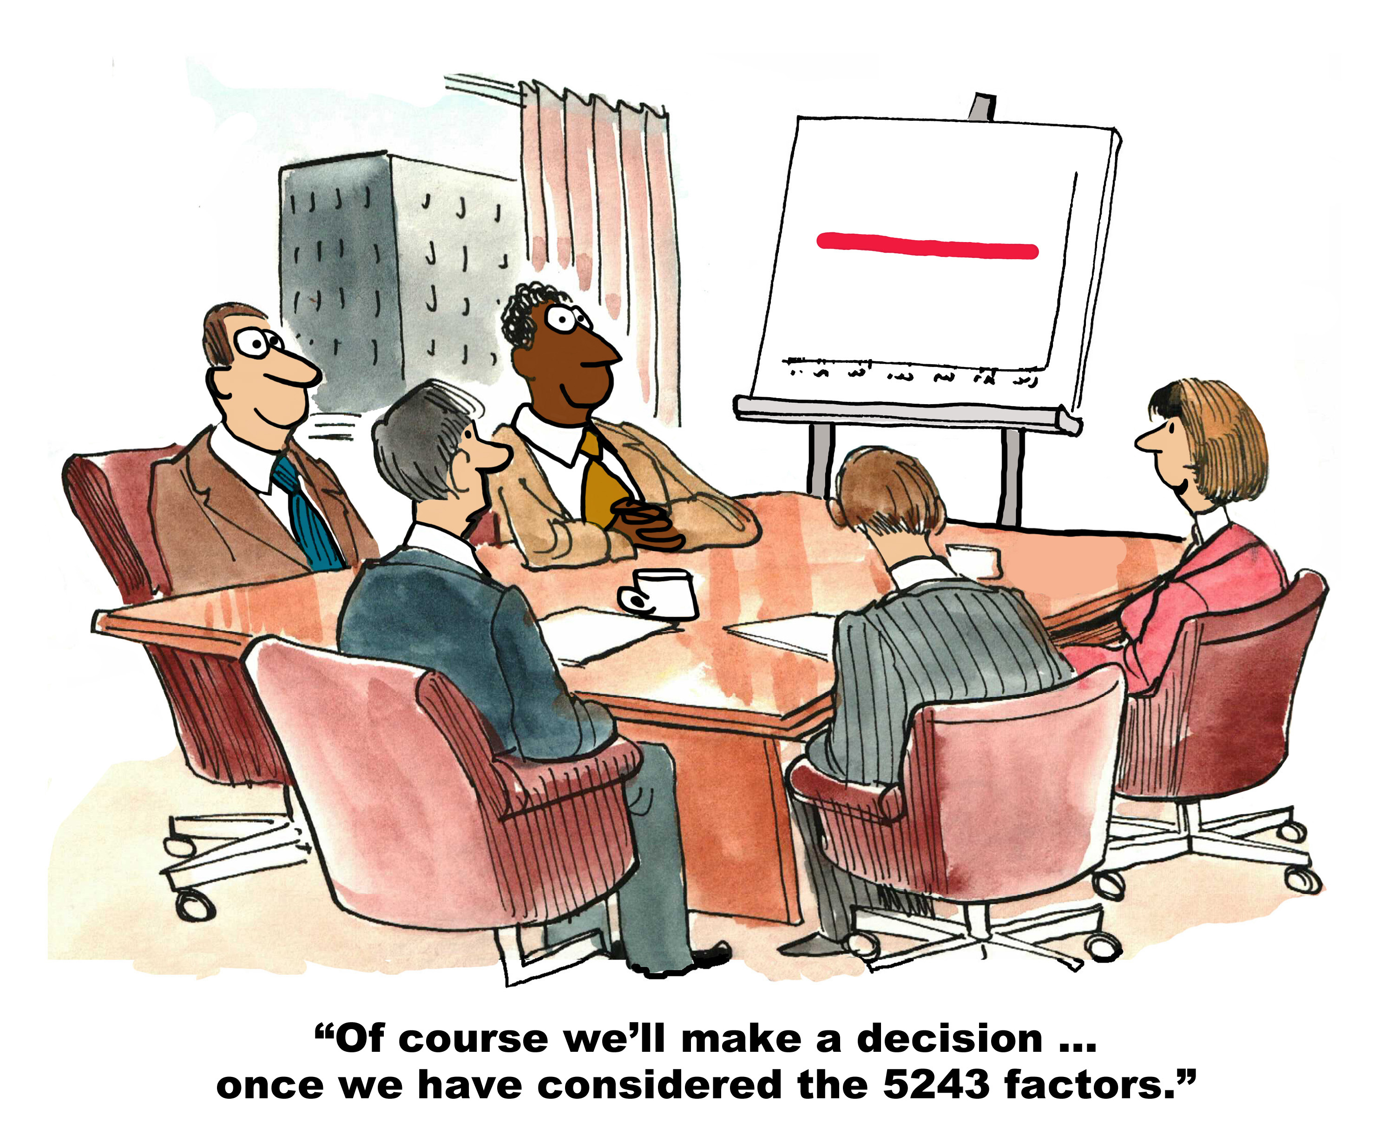

Slide 3
SalesMax.Ai
CRM – Opportunity Winning/Losing Rate
Cross Sell Analysis
Customer Retention Analysis
Sentiment Analysis

Slide 4
Tech Stack
Pandas
NumPy
Sklearn
IPython
Google Chart
Heroku

Slide 5
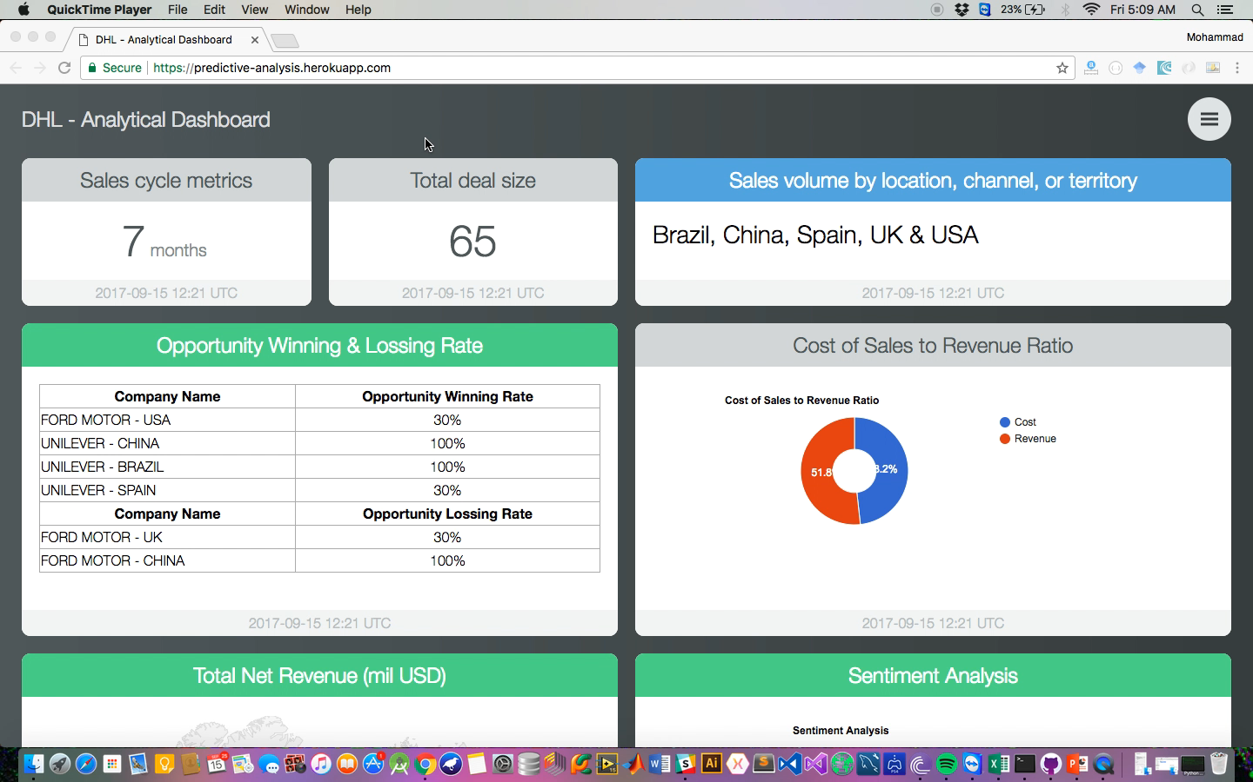
Demo

Slide 6
Future Enhancement & Possible Improvement
Custom analytic dashboard (Drag & Drop).
Build & deploy dataset using CLI.
Implement real time data with Big Data technology.

Slide 7
Team Intro
Mohammad Nurdin bin Norazan
Esa Ezzatinor bin Abdul Hamid
Nurul Azrin binti Mohd Nasir

Slide 8
Questions?

